Slide 1

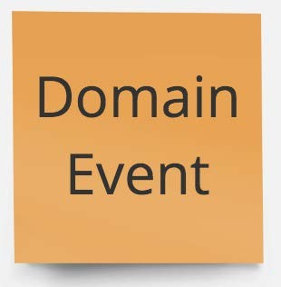
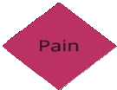
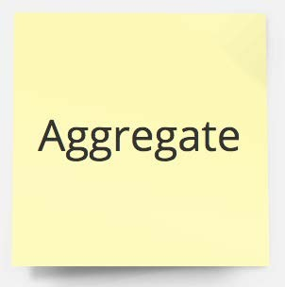
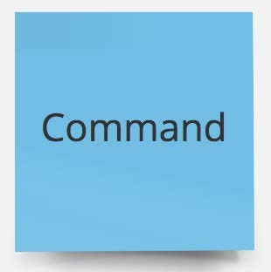

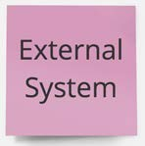

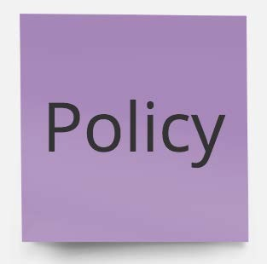

What about TESTS?

Slide 2
What about TESTS?
■
Aggregate Business Invariants:
should_not_allow_placeOrder_without_a_lineItem()

Slide 3
What about TESTS?
■
Aggregate Business Invariants:
should_not_allow_placeOrder_without_a_lineItem()
Aggregate Domain Events:
should_fire_event_when_order_placed()

Slide 4
What about TESTS?
■
Aggregate Business Invariants:
should_not_allow_placeOrder_without_a_lineItem()
Aggregate Domain Events:
should_fire_event_when_order_placed()
■
Policies:
should_check_inventory_when_order_placed()

Slide 5
what about code?

Slide 6
what about code?
class OrderLineItem
Line iteM
order
(root)
class Order
Order ID
class
OrderId

Slide 7
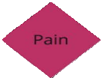

what about code?
class OrderLineItem
Line iteM
order
(root)
class Order
Order ID
class
OrderId
domain event
class OrderPlacedEvent

Slide 8
what about code?
class OrderLineItem
Line iteM
order
(root)
class Order
Order ID
class
OrderId
application Service
eventLog.subscribe(OrderPlacedEvent, e -> {});
domain event
class OrderPlacedEvent

Slide 9
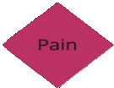
what about code?
Repository
eventLog.subscribe(ProductAddedEvent, e -> {});
class OrderLineItem
Line iteM
order
(root)
class Order
Order ID
class
OrderId
application Service
eventLog.subscribe(OrderPlacedEvent, e -> {});
domain event
class OrderPlacedEvent

Slide 10

what about code?
Repository
eventLog.subscribe(ProductAddedEvent, e -> {});
class OrderLineItem
Line iteM
order
(root)
class Order
Order ID
class
OrderId
application Service
void
placeOrder()
eventLog.subscribe(OrderPlacedEvent, e -> {});
domain event
class OrderPlacedEvent

Slide 11
thank you!
Domain-Driven Design and Event-Driven Microservices
Matt Stine (@mstine) http://mattstine.com matt.stine@gmail.com

Slide 12
Day ONE RECAP
Domain-Driven Design and Event-Driven Microservices
Matt Stine (@mstine) http://mattstine.com matt.stine@gmail.com

Slide 13
What is the State of Microservices
in 2018?

Slide 14
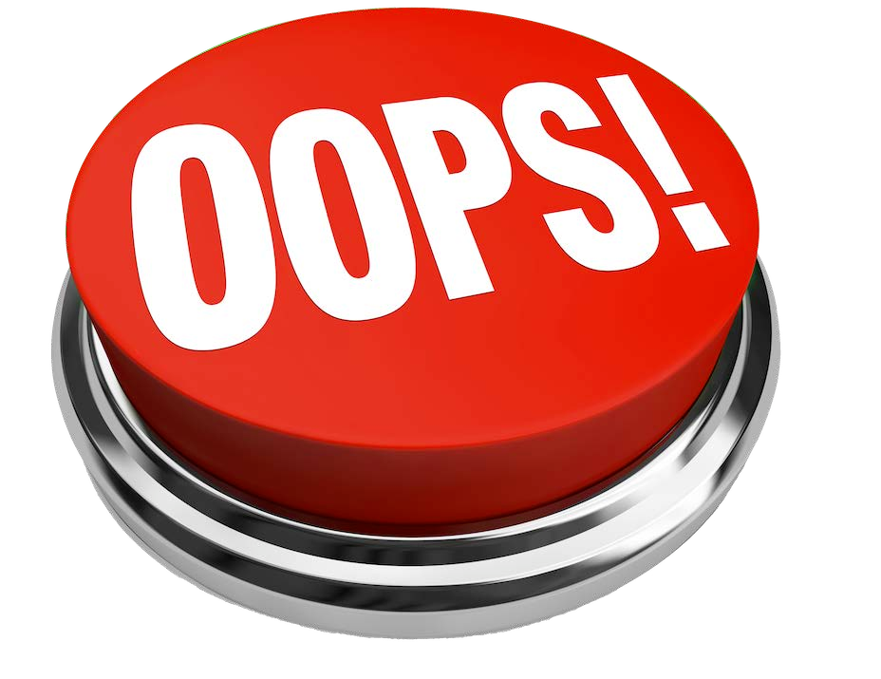
microservices ANTIPATTERNS!

Slide 15




what we’ve got here is failure to
DESIGN

Slide 16
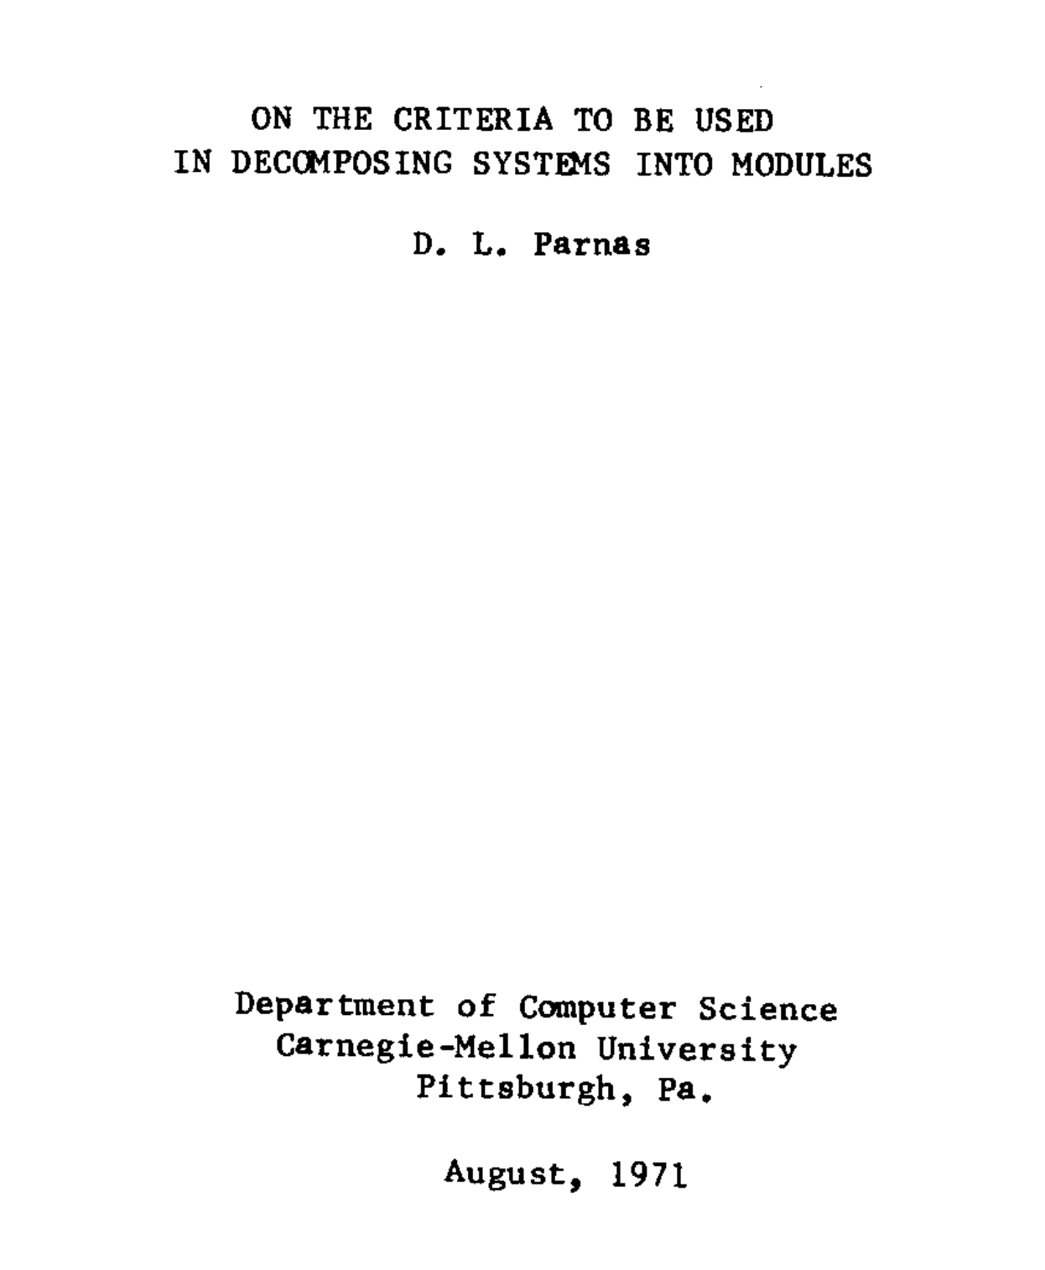

Slide 17
Functional Decomposition
Changes
Independent Development
Dependent on shared data formats and schema. Must be jointly defined and agreed upon across multiple groups.
Comprehensibility
Struggles with knowledge spread across all modules, so often each module has to change in response to a desired functional change.
You need to know something about how all of the modules work to understand the whole system.

Slide 18
Capability Decomposition
Changes
Independent Development
Has abstract interfaces that encapsulate the work to be done..
Comprehensibility
Usually isolates a change to a single module.
You can understand modules independently.

Slide 19
The fundamental ways in which we design modules effectively has not changed in the last 50 years.
Decomposition Techniques

Slide 20



DOMAIN DRIVEN DESIGN
MICROSERVICES

Slide 21
the ubiquitous language
When discussing the domain, and I use a term, and you use exactly the same term, we mean precisely the same thing.

Slide 22

Strategic Design - the view from 35,000 FEET

Slide 23
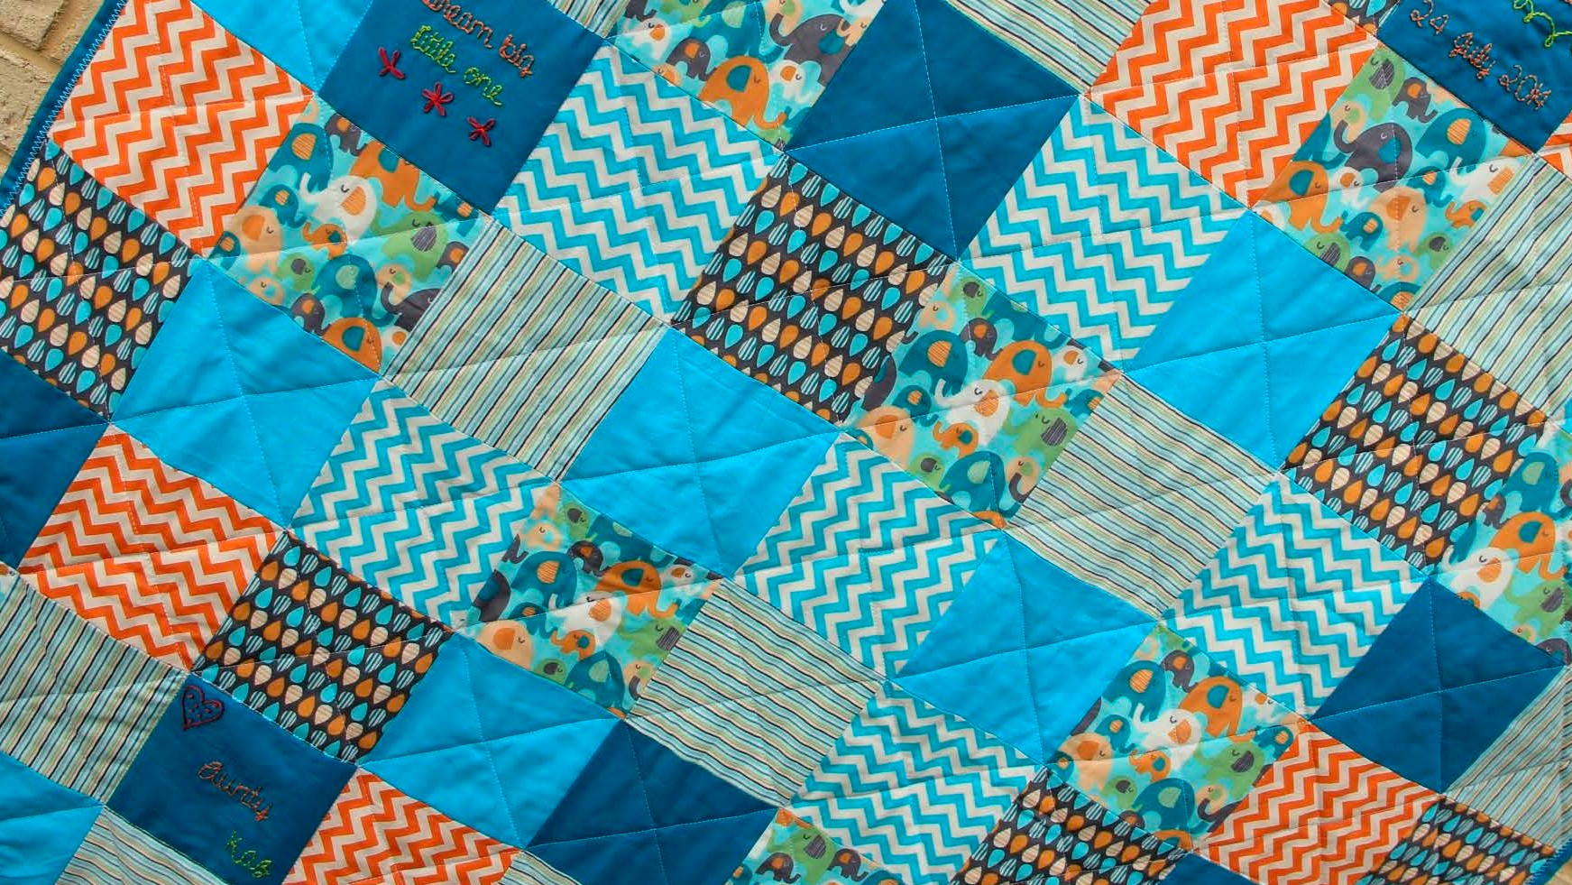


finding THE
SEAMS

Slide 24


integrating the
PIECES
"ग्राहक
"氝ਮ
!
! "
! "
!
! "
! "
ग्राहक
氝ਮ
ग्राहक
氝ਮ
"πελάτης "πελάτης "πελάτης
!
!
!

Slide 25

Tactical DESIGN?
Now it’s time to start speaking the Ubiquitous Language within each Bounded Context.
■
Business Invariants
Policies
■
Transactions
■
State
Persistence

Slide 26
the central concept
A cluster of objects treated as a single unit.
Often modeled as a state machine.
Entity
Value object
Entity
aggregate
Only accessed through its Root Entity.
The atomic unit for any transactional
behavior.
Entity
Value object
Value object
Responsible for maintaining any/all business invariants.

Slide 27
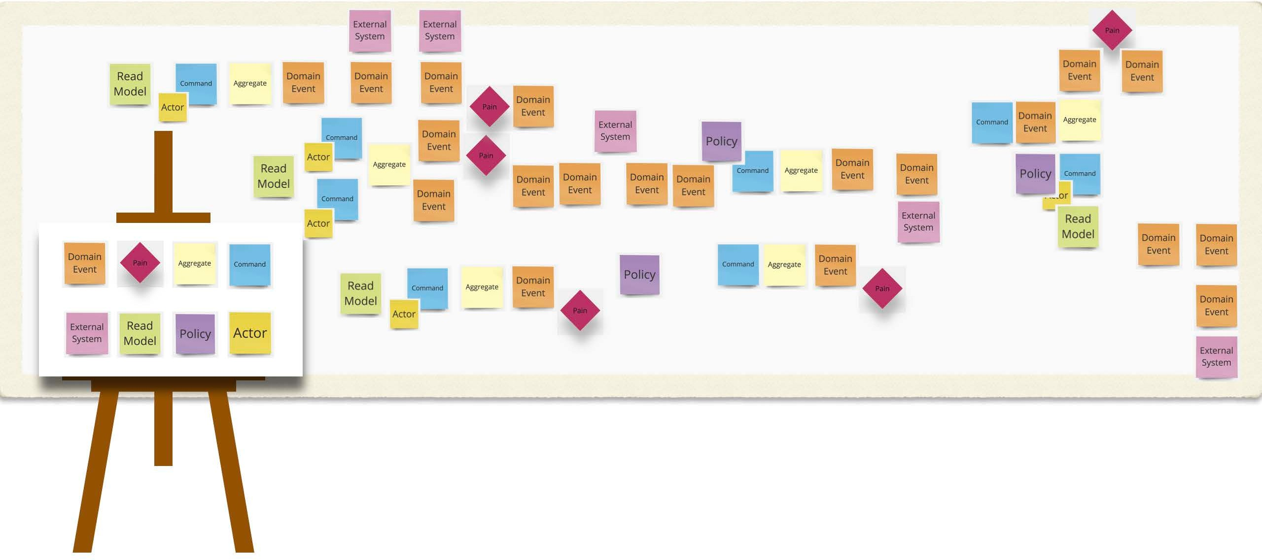
EVENT STORMING

Slide 28

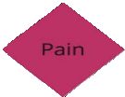

from event storm to ddd
aggregate
domain event
bounded context

Slide 29
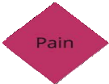
user stories
As a ROLE
I want to ACTION So that I can GOAL

Slide 30
What about TESTS?
■
Aggregate Business Invariants:
should_not_allow_placeOrder_without_a_lineItem()
Aggregate Domain Events:
should_fire_event_when_order_placed()
■
Policies:
should_check_inventory_when_order_placed()

Slide 31

what about code?
Repository
eventLog.subscribe(ProductAddedEvent, e -> {});
class OrderLineItem
Line iteM
order
(root)
class Order
Order ID
class
OrderId
application Service
void
placeOrder()
eventLog.subscribe(OrderPlacedEvent, e -> {});
domain event
class OrderPlacedEvent

Slide 32
thank you!
Domain-Driven Design and Event-Driven Microservices
Matt Stine (@mstine) http://mattstine.com matt.stine@gmail.com

Slide 33
ddd & technical architecture
Domain-Driven Design and Event-Driven Microservices
Matt Stine (@mstine) http://mattstine.com matt.stine@gmail.com

Slide 34
agenda
The Golden Rule
Hexagonal Architecture
Request/Response vs. Fire and Forget
■
Queues/Load Balancing vs. Publish-Subscribe
Introducing Persistence
Event Sourcing / CQRS
■
From Modules to Microservices

Slide 35
the golden rule
Aggregate ≤ SizeOf(Module) ≤ Bounded Context

Slide 36
the golden rule
A
Software Module
Aggregate ≤ SizeOf(Module) ≤ Bounded Context

Slide 37
the golden rule
Entity
Value object
Entity
aggregate
≤
A
Software Module
Entity
Value object
Value object
Aggregate ≤ SizeOf(Module) ≤ Bounded Context

Slide 38
the golden rule
aggregate
Entity
Value object
Entity
aggregate
≤
A
Software Module
≤
aggregate
!" ग्राहक
Entity
Value object
Value object
Aggregate ≤ SizeOf(Module) ≤ Bounded Context

Slide 39
Hexagonal Architecture
Application service

Slide 40
Hexagonal Architecture
Application service
Domain Model (Aggregates, etc.) wrapped by an Application Service
Domain Model

Slide 41
Hexagonal Architecture
Port
Port
Application service
Domain Model (Aggregates, etc.) wrapped by an Application Service
Port
Port
Domain Model
■
Ports represent generic entry/exit points (interface)
Port
Port

Slide 42
Hexagonal Architecture
Adapter
Adapter
Port
Port
Application service
Adapter
Adapter
Domain Model (Aggregates, etc.) wrapped by an Application Service
Port
Port
Domain Model
■
Ports represent generic entry/exit points (interface)
Adapter
Adapters represent specific entry/exit implementations (class)
Port
Port

Slide 43
Hexagonal Architecture
Adapter
Adapter
Port
Port
Application service
Adapter
Line iteM
Adapter
Domain Model (Aggregates, etc.) wrapped by an Application Service
order
(root)
Port
Port
Order ID
■
Ports represent generic entry/exit points (interface)
Order Repository
Adapter
Order Placed
Adapters represent specific entry/exit implementations (class)
Port
Port

Slide 44
Hexagonal Architecture
AdSaOpAtPer
AdRaEpStTer
Port
Port
Application service
AdAaMpQtPer
Line iteM
AKdAaFpKtAer
Domain Model (Aggregates, etc.) wrapped by an Application Service
order
(root)
Port
Port
Order ID
■
Ports represent generic entry/exit points (interface)
Order Repository
AdJaDpBtCer
Order Placed
Adapters represent specific entry/exit implementations (class)
Port
Port

Slide 45

Request / REsponse

Slide 46
Request / REsponse
HTTP
Outbound Gateway

Slide 47
Request / REsponse
HTTP
Outbound Gateway
http inbound gateway

Slide 48
Request / REsponse
HTTP
Outbound Gateway
http inbound gateway

Slide 49
fire and forget
RabbitMQ

Slide 50
fire and forget
AMQP
outbound gateway
RabbitMQ

Slide 51
fire and forget
AMQP
outbound gateway
AMQP
inbound gateway
RabbitMQ

Slide 52
fire and forget
AMQP
outbound gateway
AMQP
inbound gateway
RabbitMQ

Slide 53
fire and forget
AMQP
outbound gateway
AMQP
inbound gateway
RabbitMQ

Slide 54
fire and forget
AMQP
outbound gateway
AMQP
inbound gateway
RabbitMQ

Slide 55
queues / load balancing
RabbitMQ

Slide 56
queues / load balancing
AMQP
outbound gateway
RabbitMQ

Slide 57
queues / load balancing
AMQP
inbound gateway
AMQP
outbound gateway
RabbitMQ
AMQP
inbound gateway

Slide 58
queues / load balancing
AMQP
inbound gateway
AMQP
outbound gateway
RabbitMQ
AMQP
inbound gateway

Slide 59
queues / load balancing
AMQP
inbound gateway
AMQP
outbound gateway
RabbitMQ
AMQP
inbound gateway

Slide 60
queues / load balancing
AMQP
inbound gateway
AMQP
outbound gateway
RabbitMQ
AMQP
inbound gateway

Slide 61
queues / load balancing
AMQP
inbound gateway
AMQP
outbound gateway
RabbitMQ
AMQP
inbound gateway

Slide 62
queues / load balancing
AMQP
inbound gateway
AMQP
outbound gateway
RabbitMQ
AMQP
inbound gateway

Slide 63
queues / load balancing
AMQP
inbound gateway
AMQP
outbound gateway
RabbitMQ
AMQP
inbound gateway

Slide 64
queues / load balancing
AMQP
inbound gateway
AMQP
outbound gateway
RabbitMQ
AMQP
inbound gateway

Slide 65
queues / load balancing
AMQP
inbound gateway
AMQP
outbound gateway
RabbitMQ
AMQP
inbound gateway

Slide 66
queues / load balancing
AMQP
inbound gateway
AMQP
outbound gateway
RabbitMQ
AMQP
inbound gateway

Slide 67
publish - subscribe
Kafka

Slide 68
publish - subscribe
Kafka outbound gateway
Kafka

Slide 69
publish - subscribe
kafka inbound gateway
Kafka outbound gateway
Kafka
kafka inbound gateway

Slide 70
publish - subscribe
kafka inbound gateway
Kafka outbound gateway
Kafka
kafka inbound gateway

Slide 71
publish - subscribe
kafka inbound gateway
Kafka outbound gateway
Kafka
kafka inbound gateway

Slide 72
publish - subscribe
kafka inbound gateway
Kafka outbound gateway
Kafka
kafka inbound gateway

Slide 73
publish - subscribe
kafka inbound gateway
Kafka outbound gateway
Kafka
kafka inbound gateway

Slide 74
publish - subscribe
kafka inbound gateway
Kafka outbound gateway
Kafka
kafka inbound gateway

Slide 75
introducing persistence

Slide 76
introducing persistence
Repository

Slide 77
introducing persistence
Repository
jdbc repository

Slide 78
introducing persistence
Repository
jdbc repository
PostgreSQL

Slide 79
introducing persistence
Repository
jdbc repository
PostgreSQL

Slide 80
introducing persistence
Repository

Slide 81
introducing persistence
cassandra repository
Repository

Slide 82
introducing persistence
Cassandra
cassandra repository
Repository

Slide 83
introducing persistence
Cassandra
cassandra repository
Repository

Slide 84
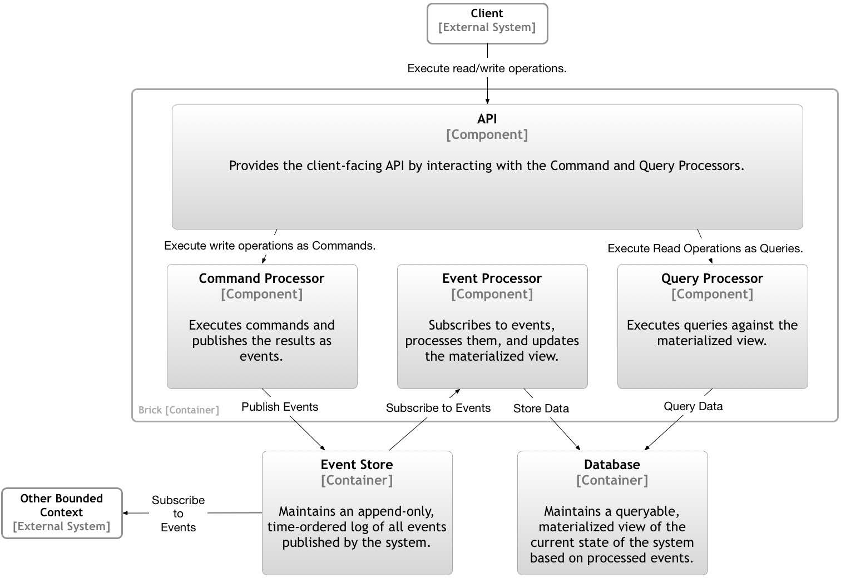
event sourcing / CQRS

Slide 85
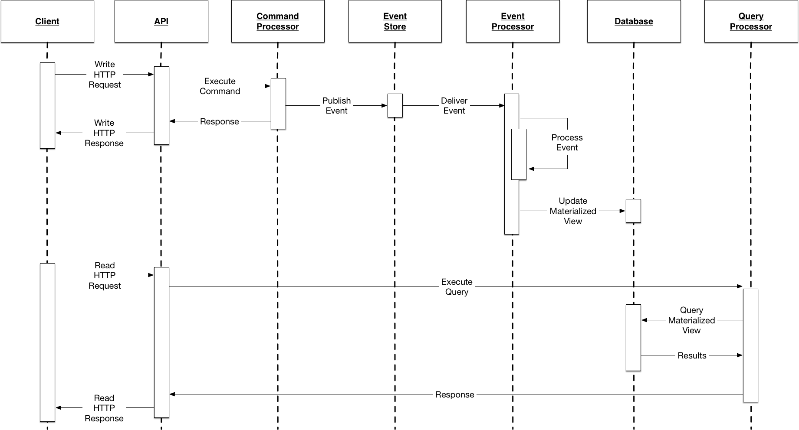
event sourcing / CQRS

Slide 86
deployment topology spectrum
BIG BALL
of mud
Monolith
Modular Monolith
Microservices

Slide 87
modules are modules
Modular Monolith Microservices
■
■
■
■
■
■
■
High Cohesion
Low Coupling
Business Capability Focus Bounded Contexts / Aggregates Data Encapsulation Substitutable
Composable
■
■
■
■
■
Individually Deployable
Individually Upgradeable Individually Replaceable Individually Scalable Heterogeneous Tech Stacks

Slide 88
The criteria for effectively creating modules inside of a monolithic codebase translates into effective criteria for microservice modularity.

Slide 89
We want to maintain a modular structure that can exist in either a monolithic or microservices architecture.

Slide 90
thank you!
Domain-Driven Design and Event-Driven Microservices
Matt Stine (@mstine) http://mattstine.com matt.stine@gmail.com

